Slide 1
ENTERPRISE RESOURCE PLANNING
FI MODULE IN SAP

Slide 2
Financial functions supported by ERP
Accounts receivable
Asset account
Cash forecast
Cost accounting
Executive Information System
Financial consolidation
General ledger
Profit analysis

Slide 3
FI vs CO
FI
Legal or External Reporting
Reports by Accounts
CO
Internal Management Reporting
Cost Center Reports
Balance Sheet
Income Statement

Slide 4
FI Module
FI
AR
AP
SL
CON
AM
GL

Slide 5
FI Module Components
Account Receivables
Records all account postings generated as a result of Customer sales activity.
Postings are automatically updated in the General Ledger
Accounts Payable
Records account postings generated as a result of Vendor purchasing activity.
Automatic postings are generated in the General Ledger as well
Asset Accounting
Utilized for managing your company’s Fixed Assets
SAP allows you to categorize assets and to set values for depreciation calculations in each asset class

Slide 6
FI Module Components Contd.
Bank Accounting
Allows for management of bank transactions in the system including cash management.
Consolidation
Enables the combining of financial statements for multiple entities within an organization
These statements provide an overview of the financial position of the company as a whole.
Funds Management
Allows management to set budgets for revenues and expenses within your company as well as track these to the area of responsibility

Slide 7
FI Module Components Contd.
General Ledger
Fully integrated with the other SAP Modules
All accounting postings are recorded here
These postings are displayed in real-time providing up-to-date visibility of the financial accounts
Special Purpose Ledger
Used to define ledgers for reporting purposes
Data can be gathered from internal and external applications
Travel Management
Provides management of all travel activities including booking trips and handling of expenses associated with travel

Slide 8
FI/CO Organizational Structure
Client
Company
Company Code
Business Area
Chart of Accounts
Credit Control Area
Controlling Area

Slide 9
FI Module Configurations
Tax on sale and Purchases
Assigning Country to Calculation
Defining Condition Types
Checking Calculation Procedure
Specifying Structure for Tax Jurisdiction Codes
Defining Tax Jurisdictions
Defining Tax codes for Sales and Purchases
House Banks

Slide 10
TAX ON SALE AND PURCHASES

Slide 11
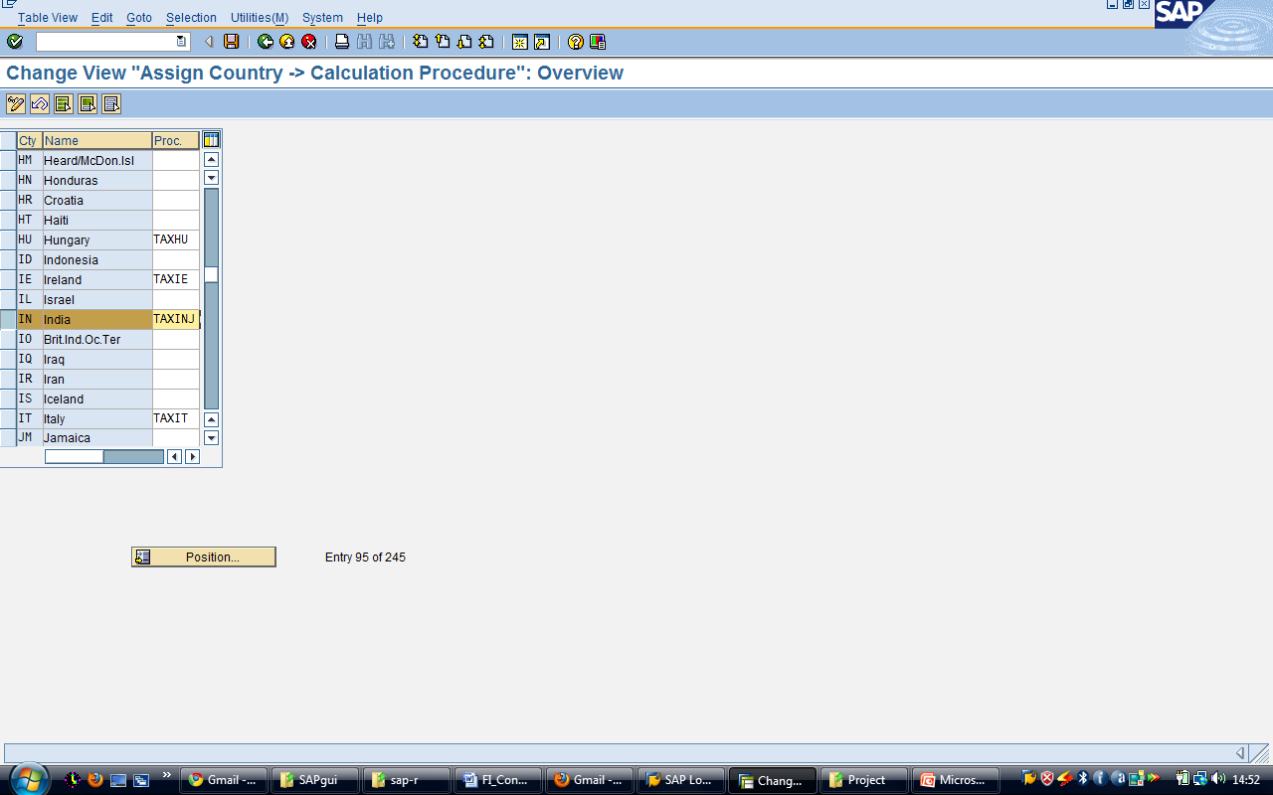
Assigning Country to Calculation
Transaction Code: SPRO or OBBG
IMG Menu: Financial Accounting → Financial Accounting global settings → Tax on Sales /Purchases → Basic Settings → Assign Country to Calculation Procedure

Slide 12
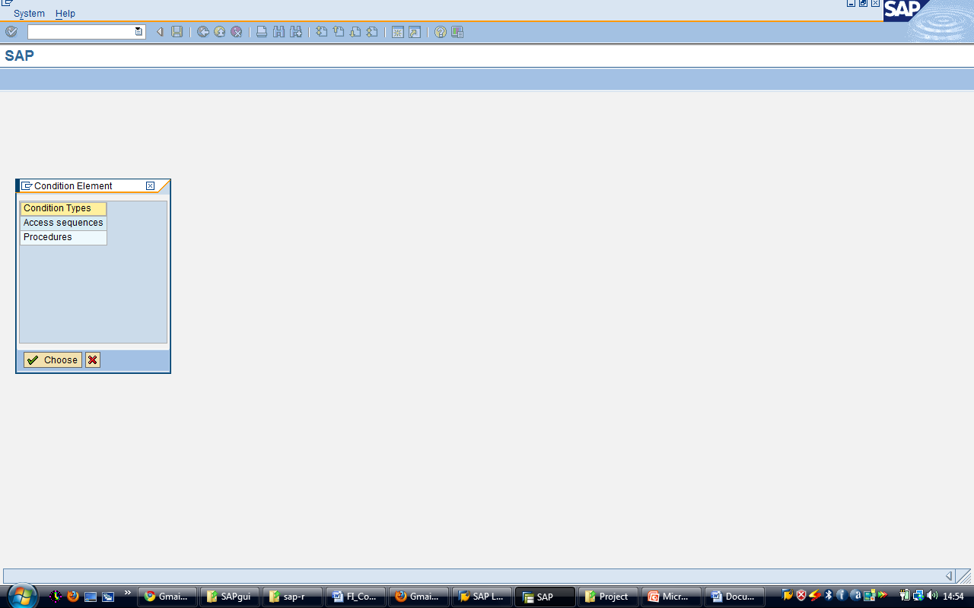
Defining Condition Types
Transaction Code: SPRO or OBYZ
IMG Menu: Financial Accounting → Financial Accounting global settings → Tax on Sales /Purchases → Basic Settings → Check Calculation Procedure

Slide 13
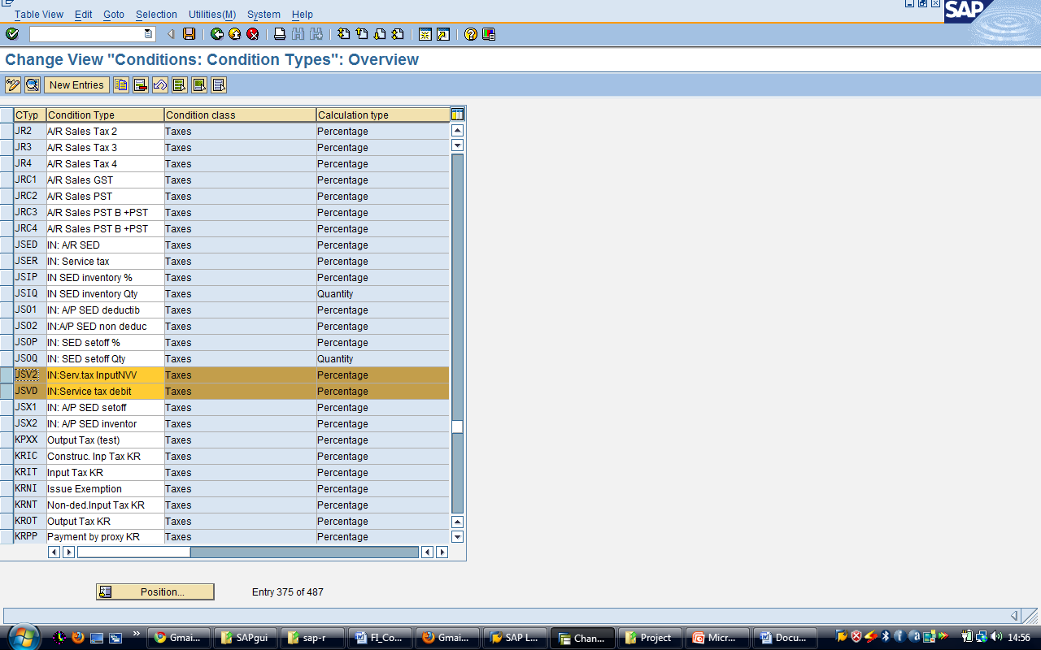
Change view “Conditions: Condition Types”: Overview screen

Slide 14
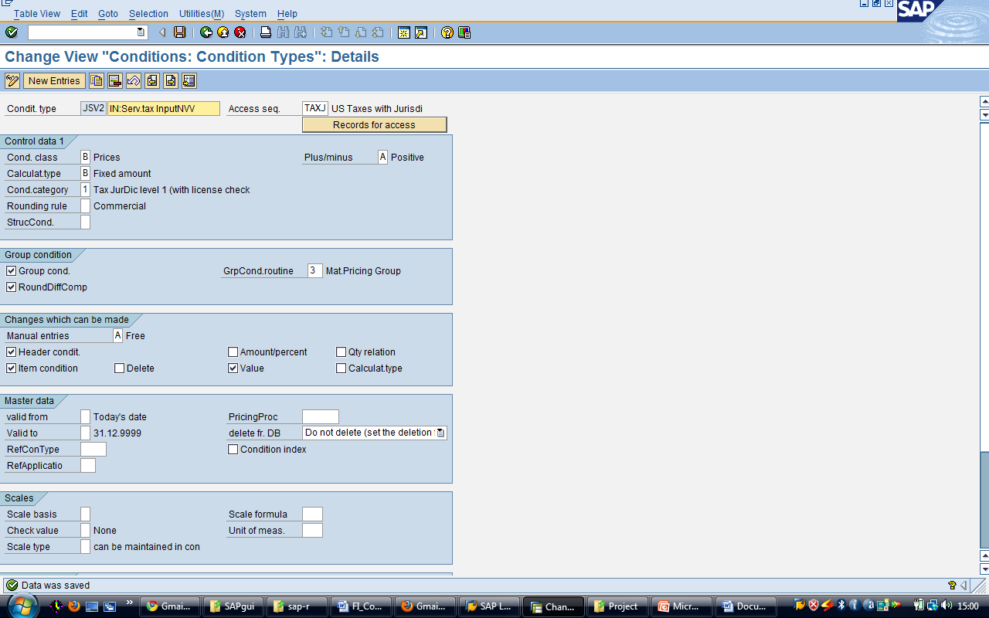
Change view “Conditions: Condition Types”: Details screen

Slide 15
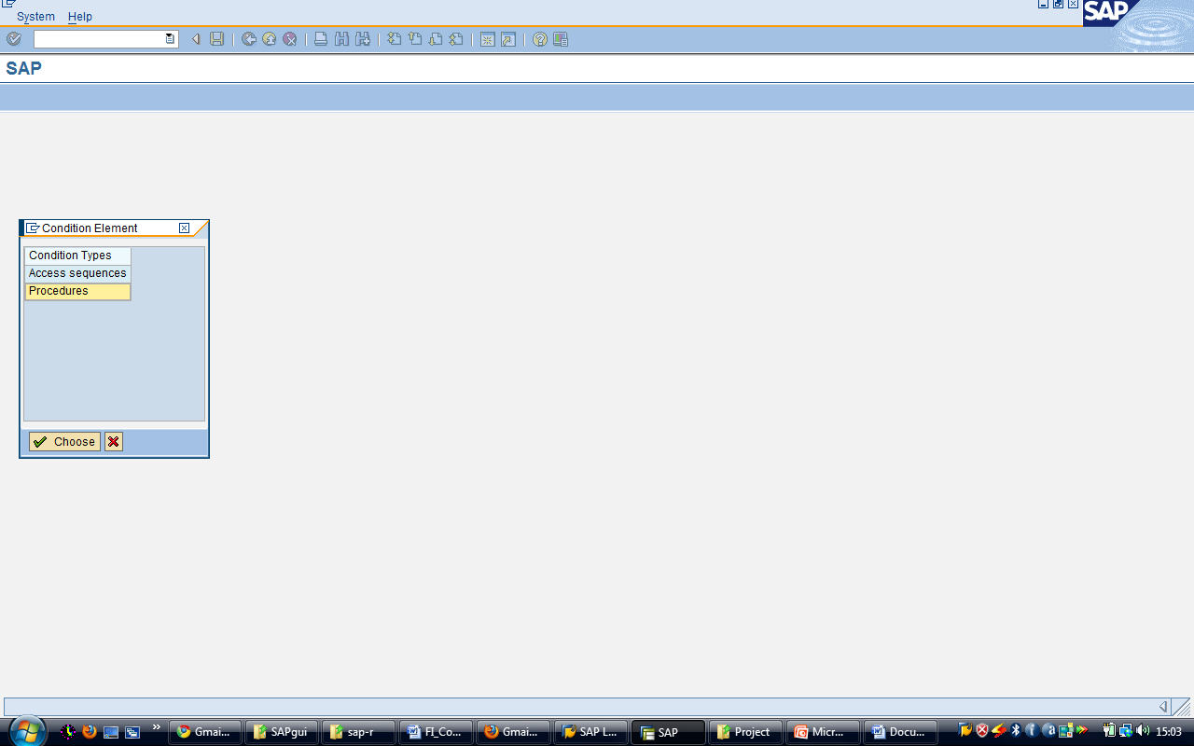
Checking Calculation Procedure
Transaction Code: SPRO or OBYZ
IMG Menu: Financial Accounting → Financial Accounting global settings → Tax on Sales /Purchases → Basic Settings → Check Calculation Procedure

Slide 16
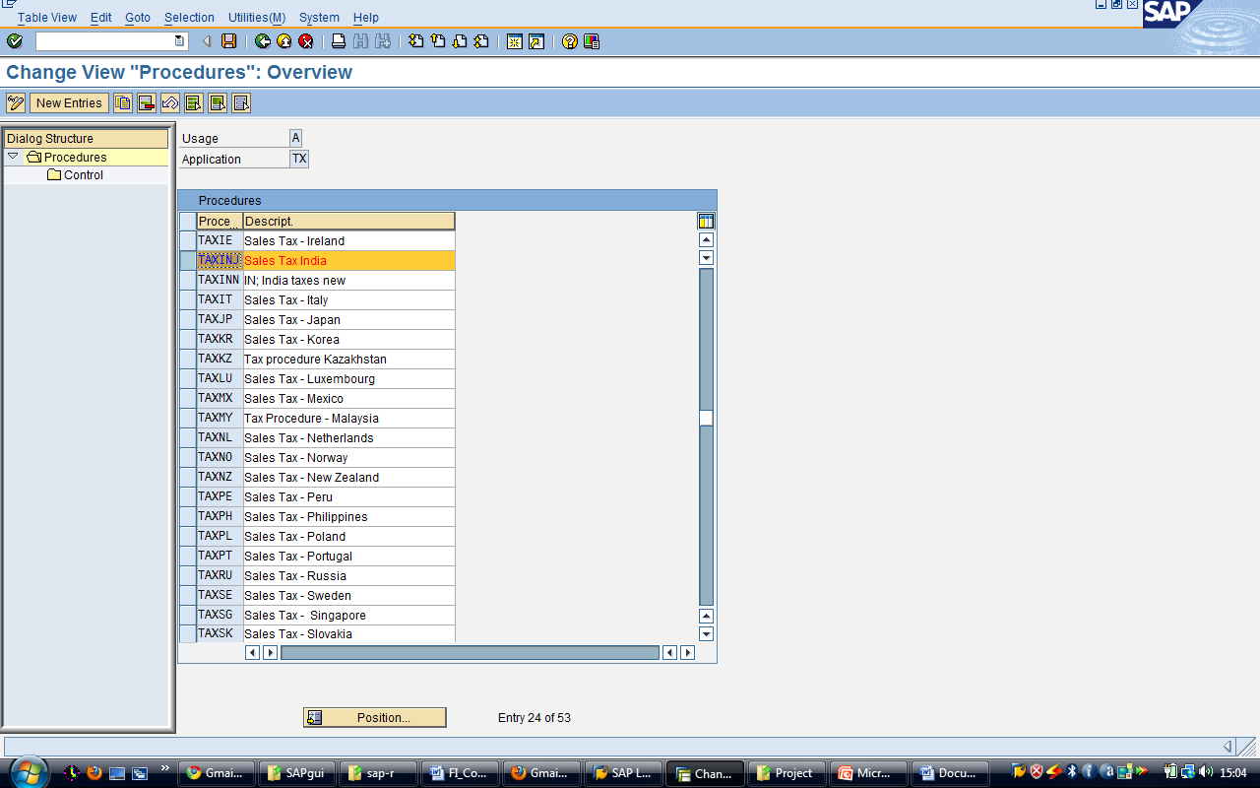
Change View “Procedures”: Overview screen

Slide 17
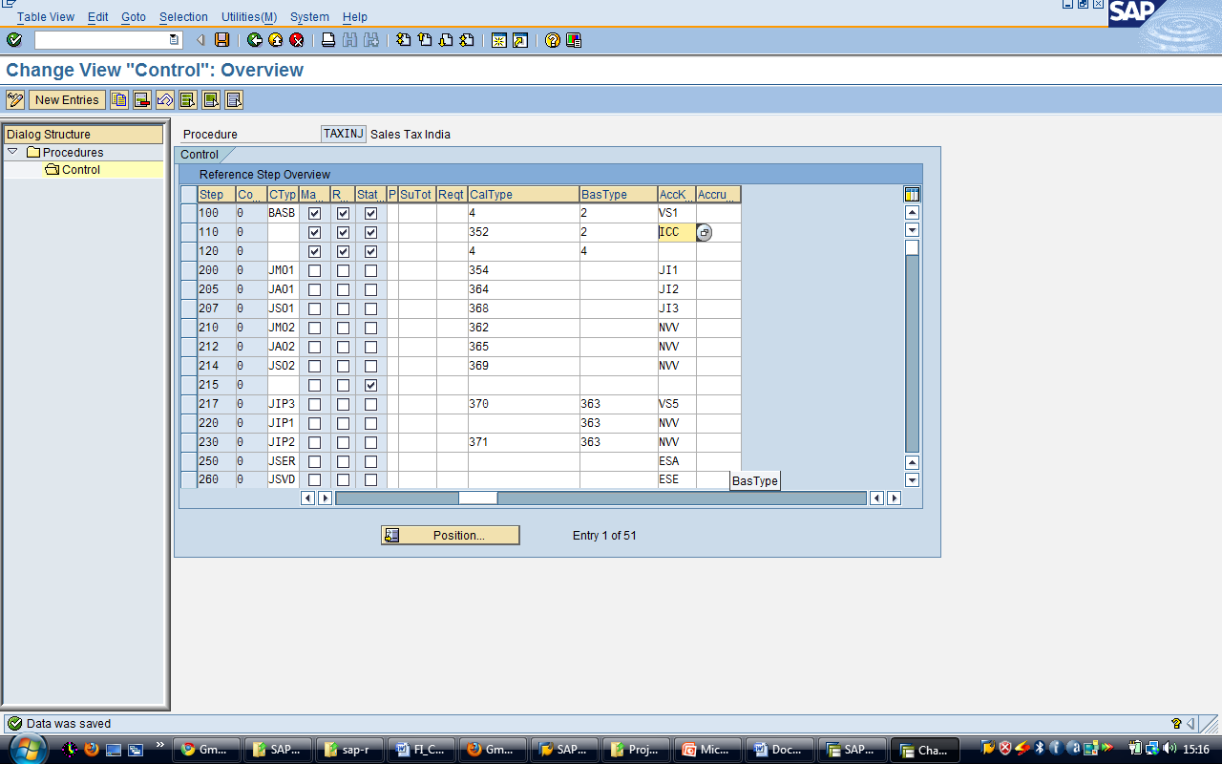
Change View “Control”: Overview screen

Slide 18
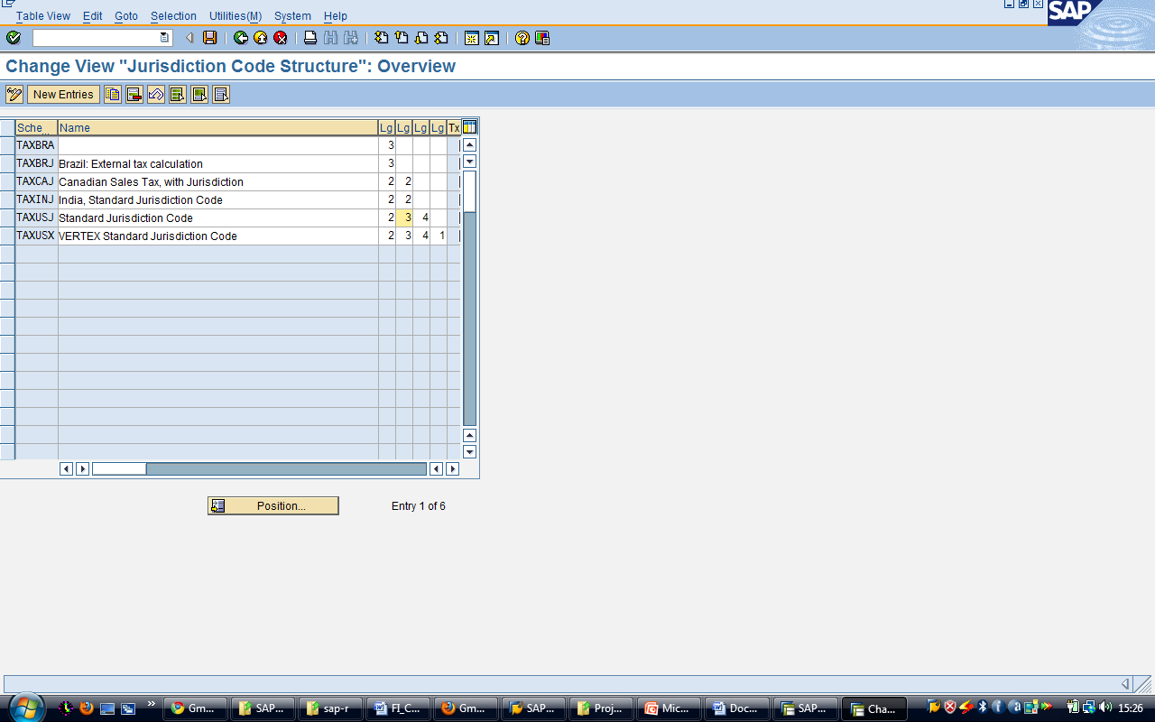
Specifying Structure for Tax Jurisdiction Codes
Transaction Code: SPRO or OBCO
IMG Menu: Financial Accounting → Financial Accounting global settings → Tax on Sales /Purchases → Basic Settings → Specify Structure for Tax Jurisdiction Codes

Slide 19
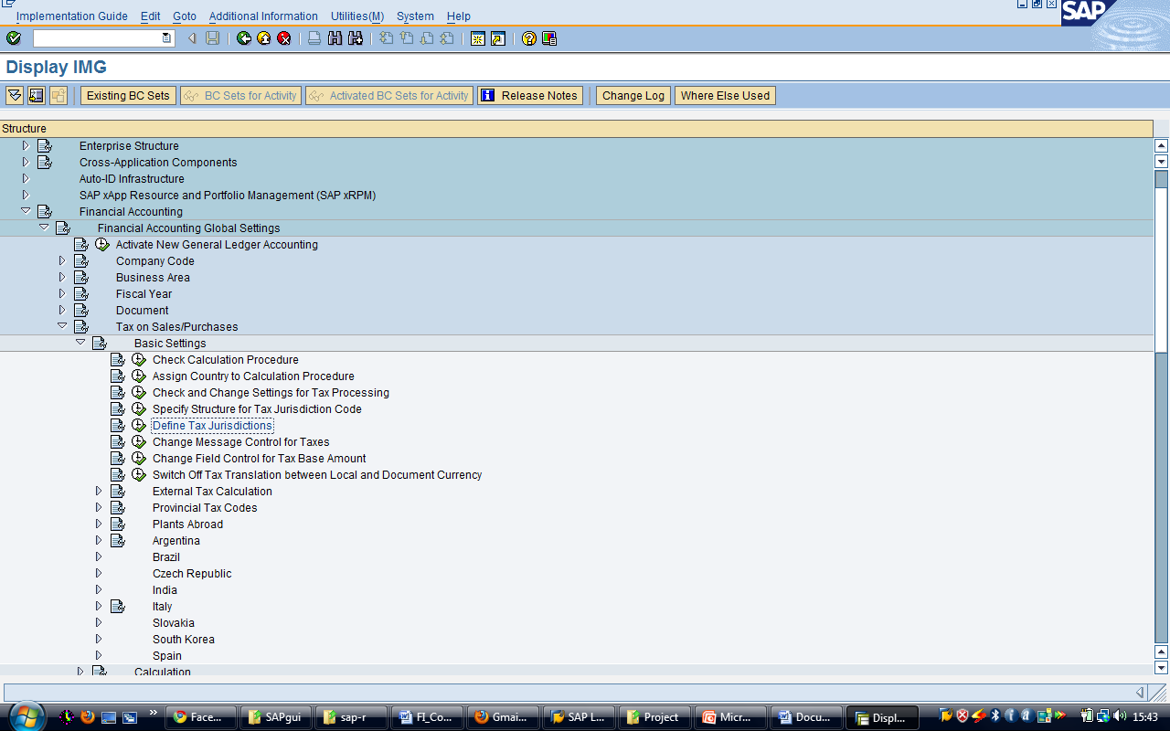
Defining Tax Jurisdictions
Transaction Code: SPRO or OBCP
IMG Menu: Financial Accounting → Financial Accounting global settings → Tax on Sales /Purchases → Basic Settings → Define Tax Jurisdictions

Slide 20
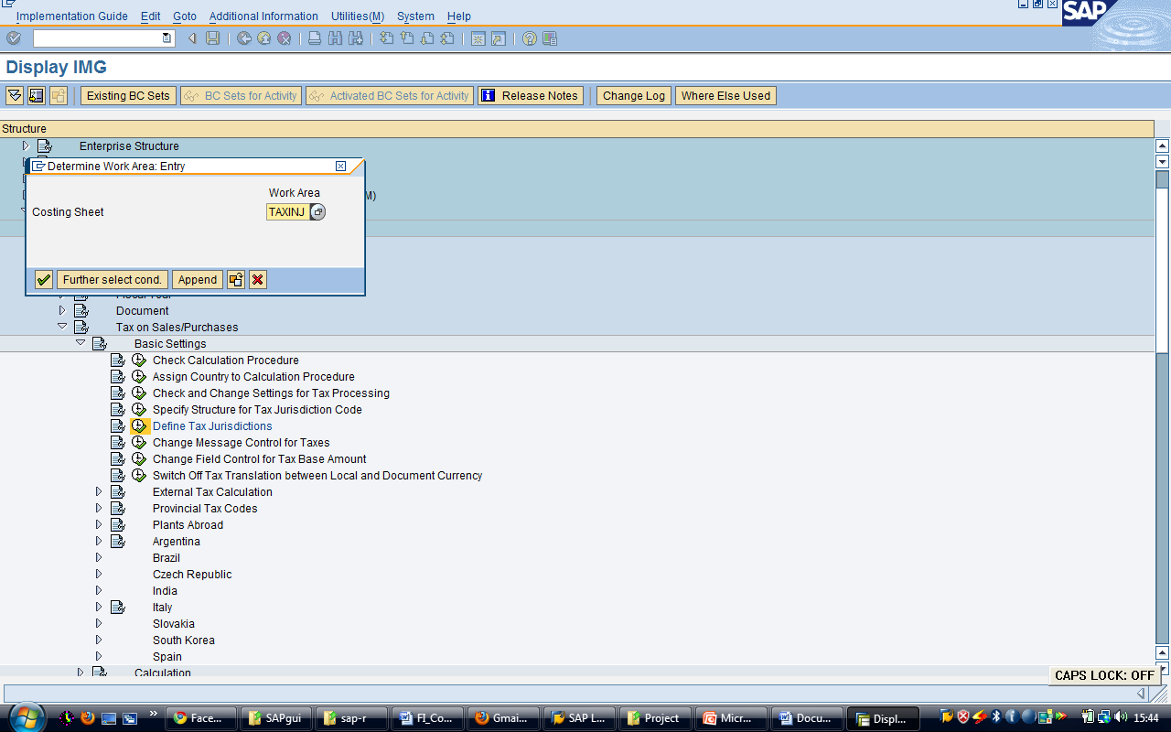
Display IMG Screen

Slide 21
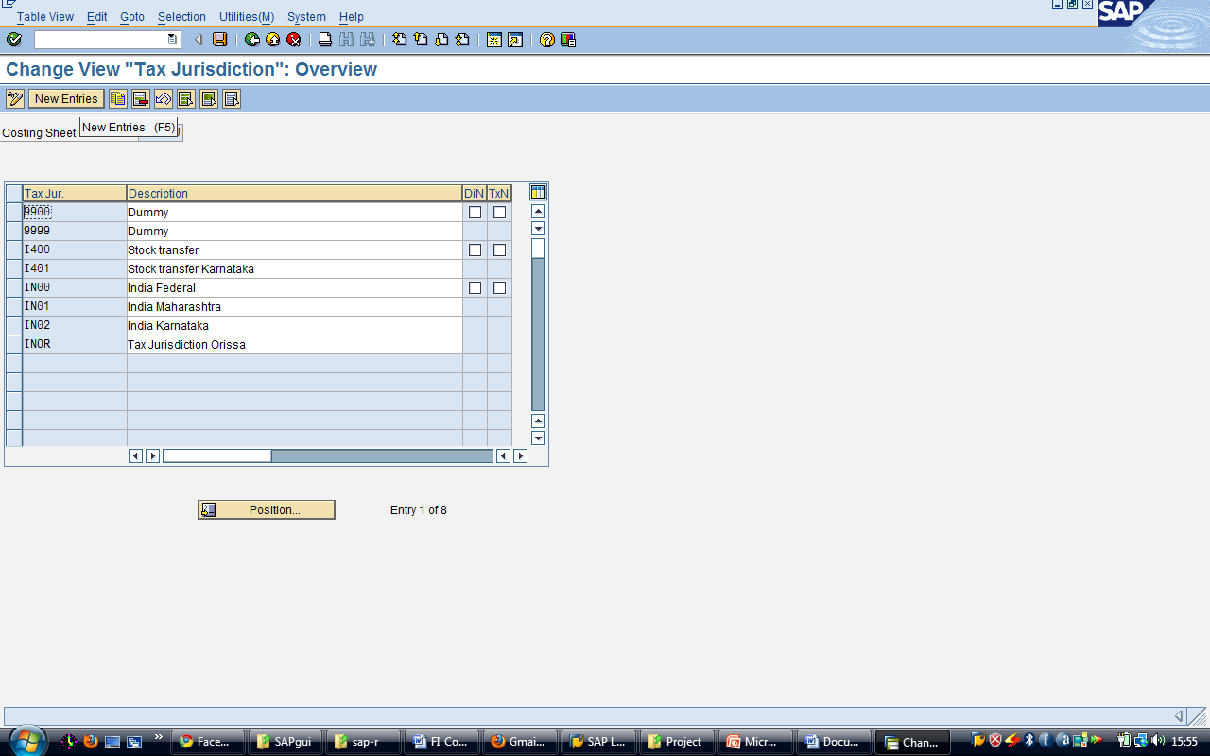
Change View “Tax Jurisdiction”: Overview screen

Slide 22
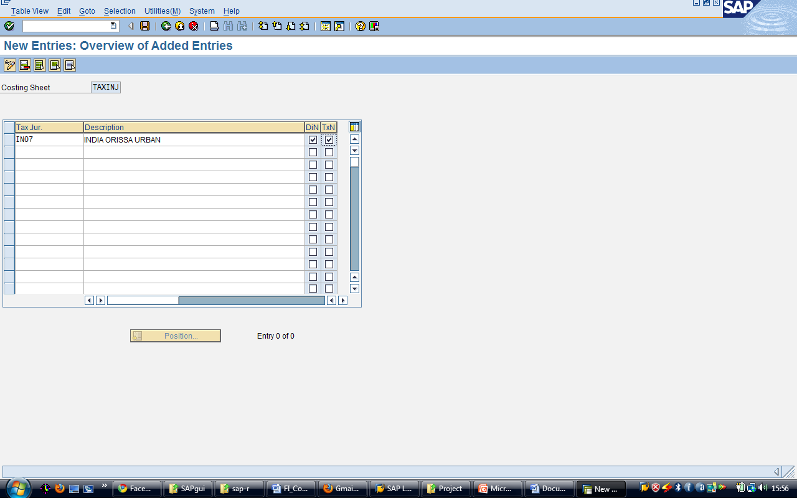
New Entries : Overview of Added Entries screen

Slide 23
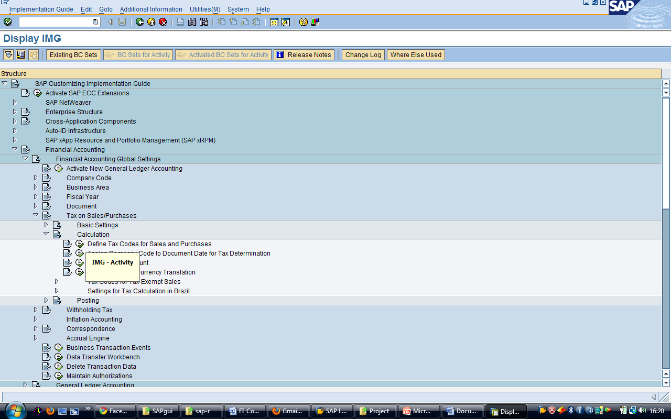
Defining Tax Codes for Sale and Purchases
Transaction Code: SPRO or FTXP
IMG Menu: Financial Accounting → Financial Accounting global settings → Tax on Sales / Purchases → Calculation → Define tax codes for sales and purchases

Slide 24
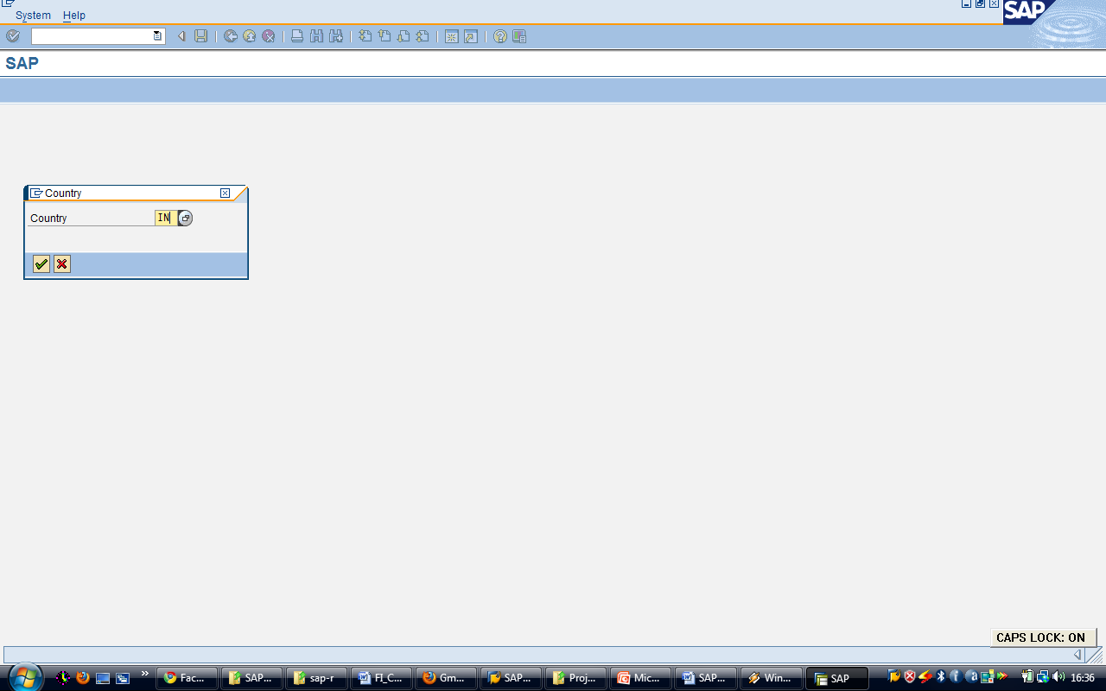
Pop – Up Screen

Slide 25
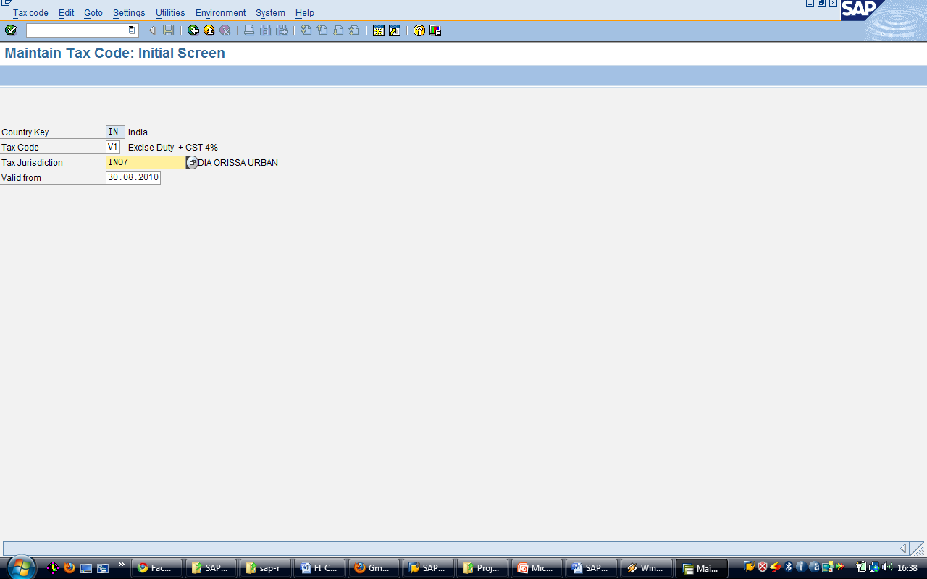
Maintain Tax Code: Initial screen

Slide 26
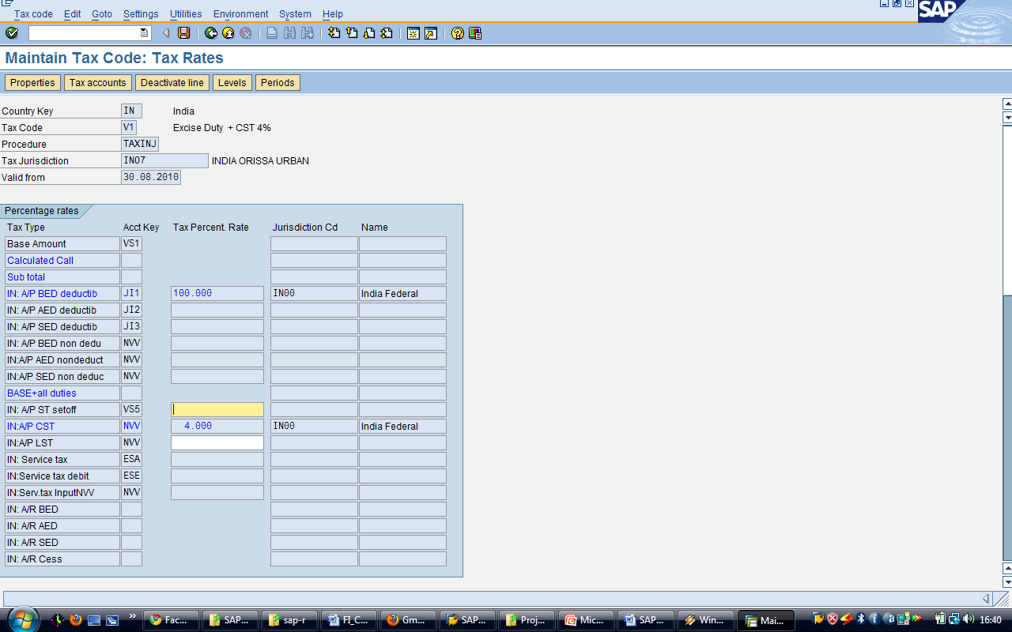
Maintain Tax Code: Tax Rates screen

Slide 27
TAX ON SALE AND PURCHASES (ADDITIONAL SETTINGS)

Slide 28
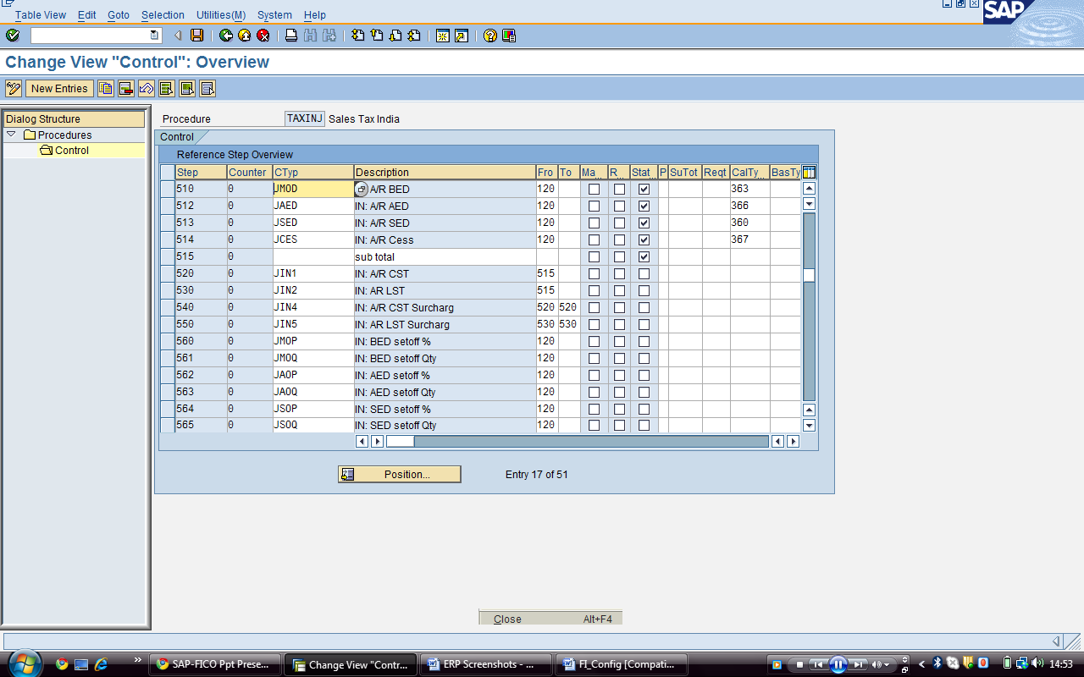
Checking Calculation Procedure
Transaction Code: SPRO or OBYZ
IMG Menu: Financial Accounting → Financial Accounting global settings → Tax on Sales /Purchases → Basic Settings → Check Calculation Procedure
Notes:
On the pop screen select the Define Procedure.
On the Change View “Procedures”: Overview screen select the Tax procedure TAXINJ and double click on the Control data.
On the Change View “Control Data”: Overview screen made the following changes in the Tax Procedure:
510 JMOD Activate As deactivated to define the Tax Code
512 JAED Activate If it is deactivated to define the Tax code activate
513 JSED Activate If it is deactivated to define the Tax code activate
514 JCES Activate If it is deactivated to define the Tax code activate

Slide 29
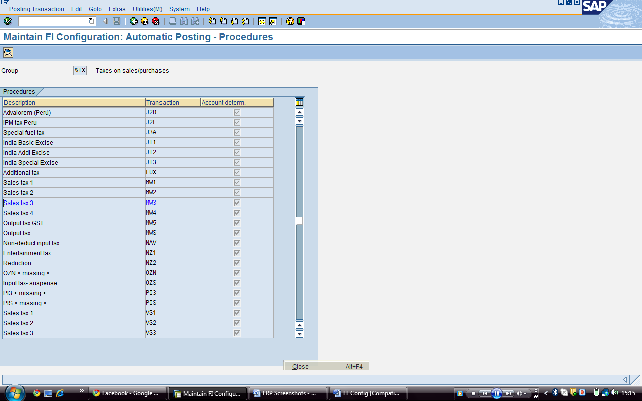
Defining Tax Accounts
Transaction Code: SPRO or OB40
IMG Menu: Financial Accounting → Financial Accounting global settings → Tax on Sales /Purchases → Posting → Define Tax Accounts
Notes:
Use: The purpose of this activity is to assign the General ledger master record to post the taxes to the clearing accounts.
You go to Procedures screen and add the GL account Transaction
Prerequisites
The General Ledger Account must be created in the Company Code.
If required maintain the General Ledger Accounts on the open item basis to clear the line items and also check the tax relevancy.
Change:
Transaction Purpose of usage in tax procedure Rule Tax Code GL Account
MW3- Sales tax 3 To post the LST sales tax on Sales Tax Code is Active A1 A3 13113410 13113410
MWS- Output tax To post the CST sales tax on Sales Tax Code is Active A2 A4 13113400 13113400

Slide 30
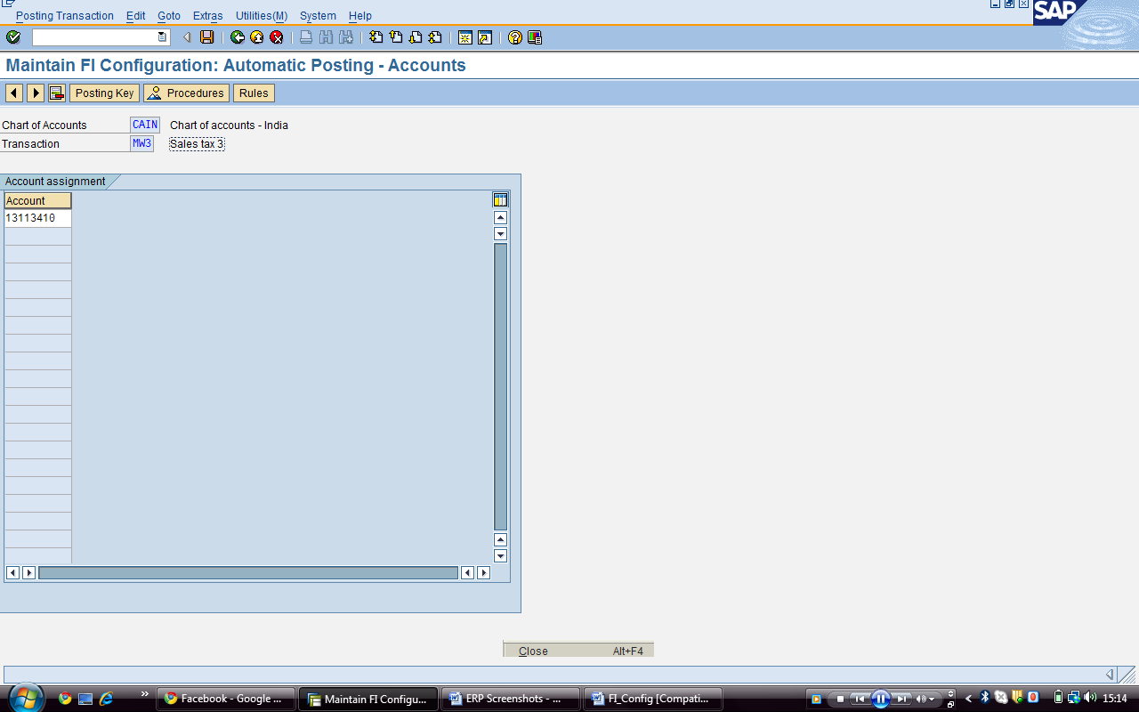
Maintain FI Configuration Automatic Posting – Accounts Screen

Slide 31
HOUSE BANKS

Slide 32
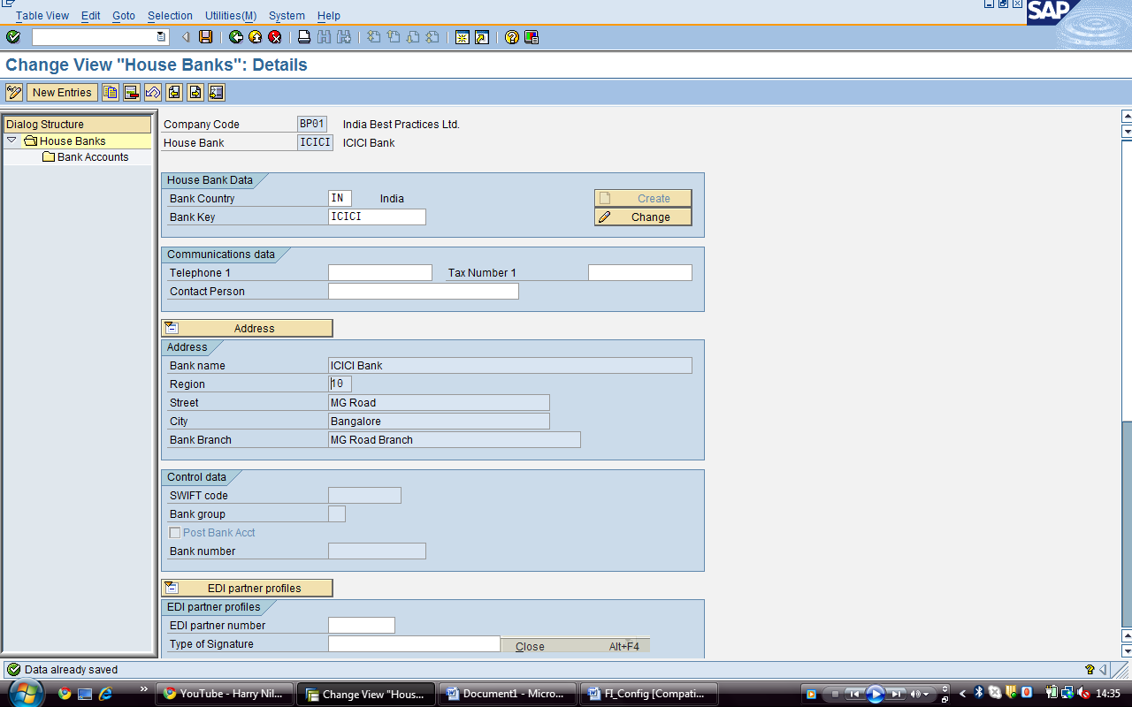
Defining House Bank
Transaction Code: SPRO or FI12
IMG Menu: Financial Accounting → Bank Accounting → Bank Accounts → Define House Banks
Notes:
House Bank: Defines all the bank related data

Slide 33
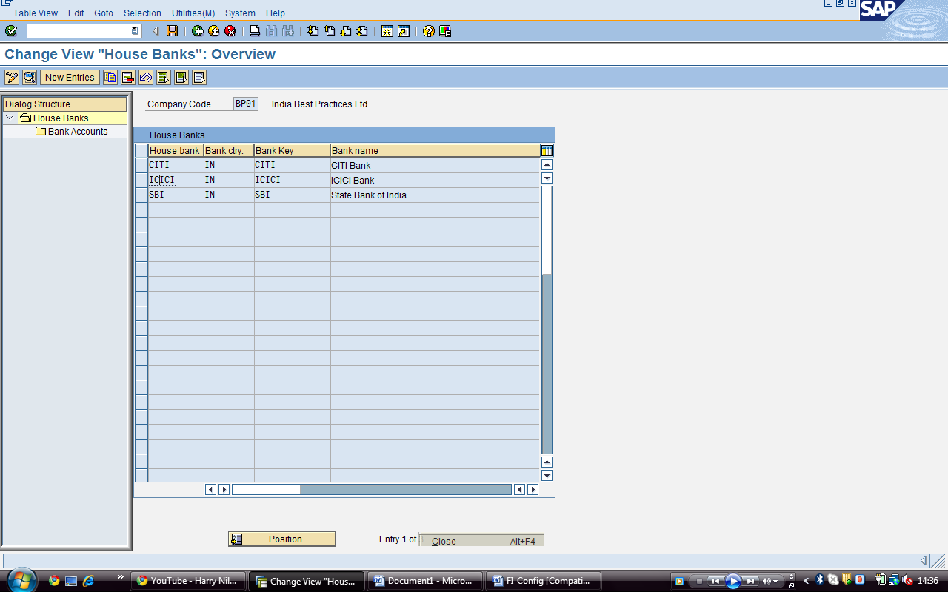
Change View “House Banks” : Overview Screen
Notes:
There are a no. of banks already defined…we have defined ICICI bank

Slide 34
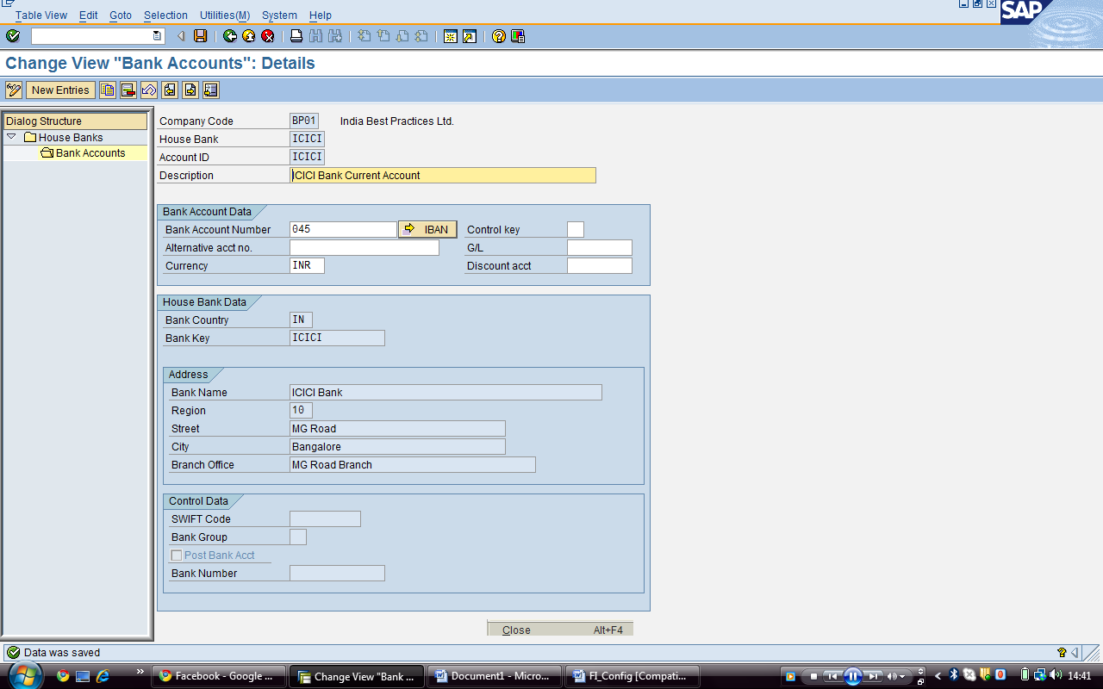
Change View “Bank Accounts” : Details Screen
Notes:
Use Green arrow or press F3 and you are in Change View “House Banks”: Overview screen
Select the House bank ID and double click on the Bank Accounts
To enter the Bank Accounts use New Entries push button Change View “Bank Accounts”: Overview screen and maintain the following values:

Slide 35
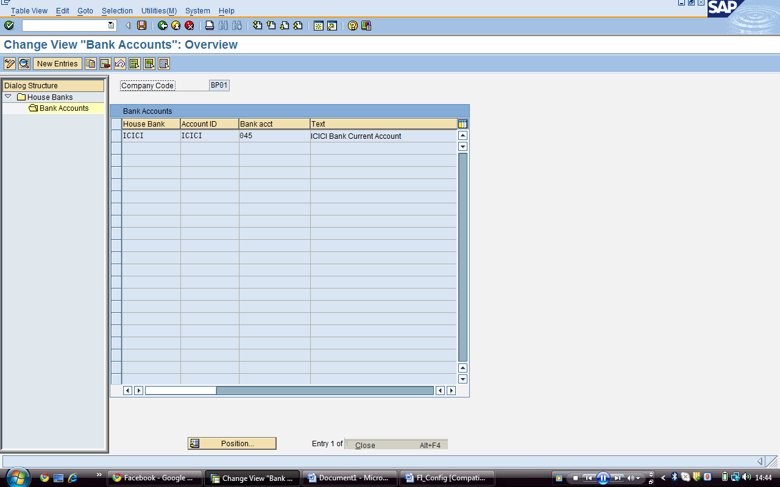
Change View “Bank Accounts” : Overview Screen

Slide 36
THANK YOU....

